Slide 1
Effective theories for nonequilibrium matter: generalized time-reversal symmetry
2310.12233
Jack H. Farrell (CU Boulder)
APS March Meeting
2024-03-06

Slide 2

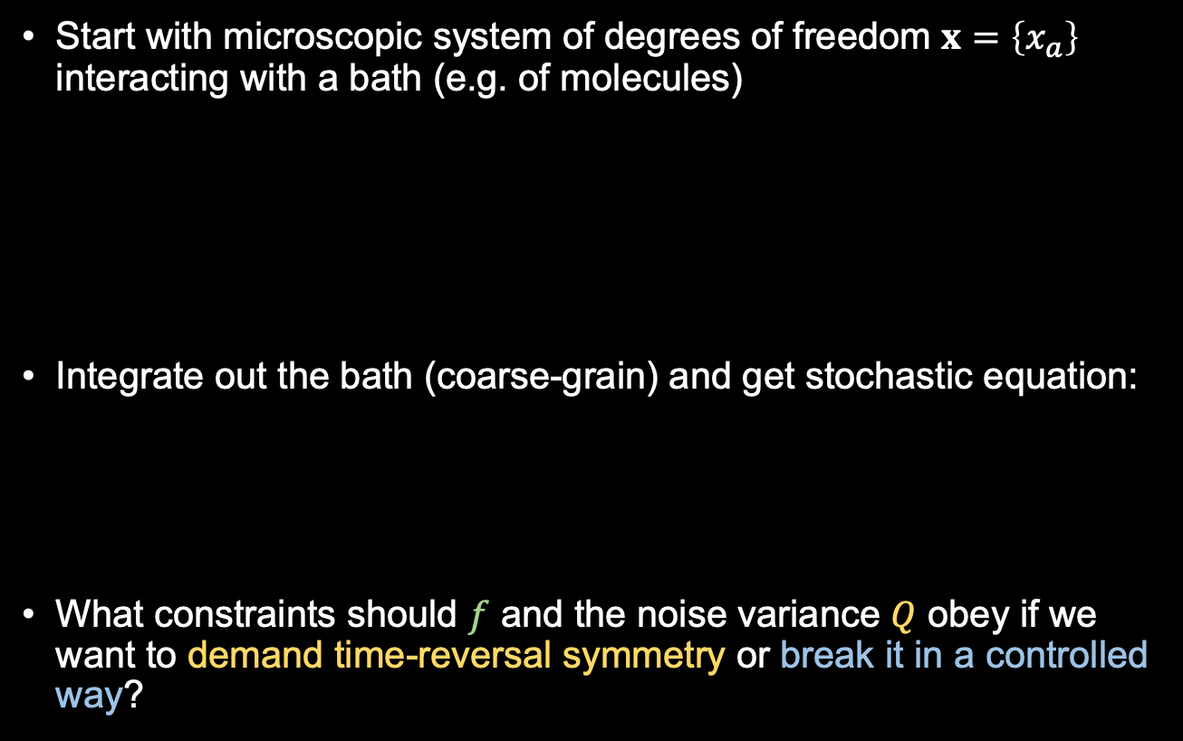

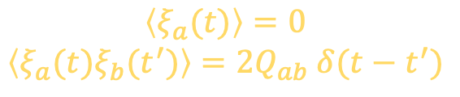
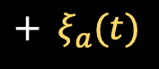
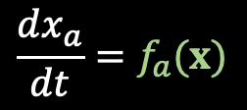

Time-reversal and dissipation
Start with microscopic system of degrees of freedom $x=\left\{x_{a}\right\}$ interacting with a bath (e.g. of molecules)
Integrate out the bath (coarse-grain) and get stochastic equation:
What constraints should $f$ and the noise variance $Q$ obey if we want to demand time-reversal symmetry or break it in a controlled way?
$$x_{1}$$
$$x_{2}$$
$$x_{3}$$
$$\frac{dx_{a}}{dt}=f_{a}(x)$$
$$\left\langle ξ_{a}(t)\right\rangle =0$$
$$\left\langle ξ_{a}(t)ξ_{b}(t^{′})\right\rangle =2Q_{ab} δ(t−t^{′})$$
$$+ ξ_{a}(t)$$
Notes:
talk

Slide 3
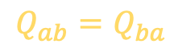

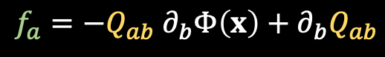
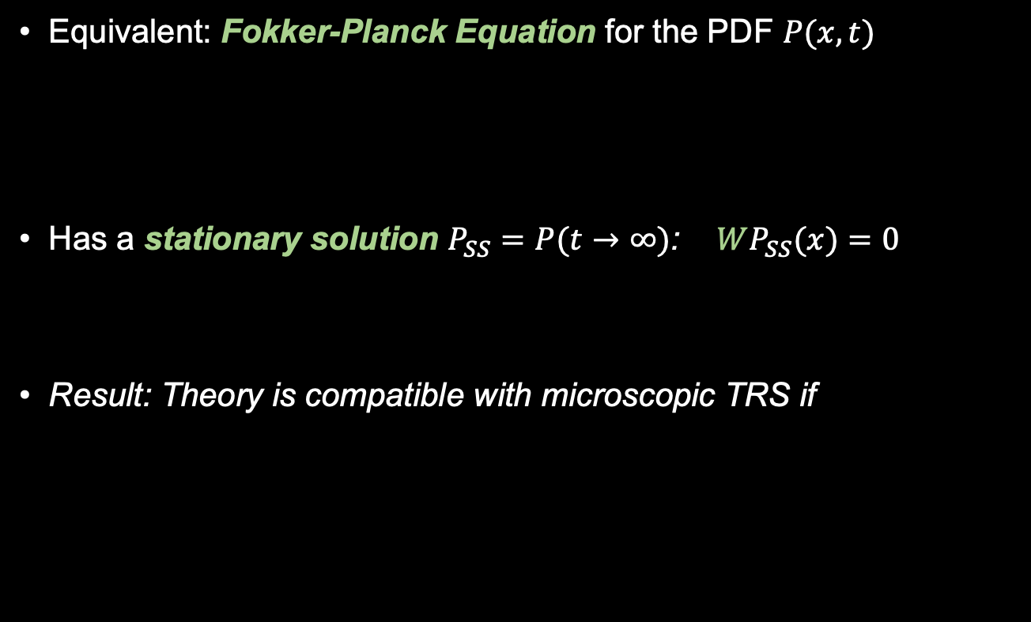

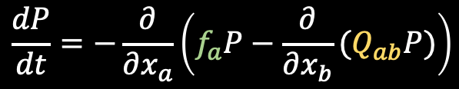
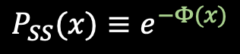
Time-reversal and dissipation
Equivalent: Fokker-Planck Equation for the PDF $P(x,t)$
Has a stationary solution $P_{SS}=P(t→∞)$: $WP_{SS}(x)=0$
Result: Theory is compatible with microscopic TRS if
$$\frac{dP}{dt}=−\frac{∂}{∂x_{a}}\left(f_{a}P−\frac{∂}{∂x_{b}}{(Q}_{ab}P)\right)$$
$$≡−WP$$
$$P_{SS}(x)≡e^{−Φ(x)}$$
$$W=e^{−Φ}W^{T}e^{Φ}$$
$$f_{a}=−Q_{ab} ∂_{b}Φ\left(x\right)+∂_{b}Q_{ab}$$
$$Q_{ab}=Q_{ba}$$

Slide 4

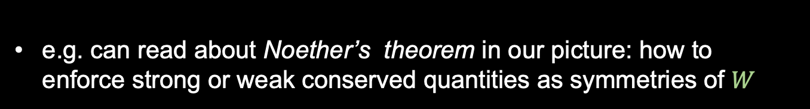

Effective theory
Our plan to describe a given system:
Write down a general $Φ$ in a controlled ”Wilsonian” expansion (e.g. gradient expansion, for field theories)
Build the most general $W$ satisfying desired symmetries and
$$W=e^{−Φ}W^{T}e^{Φ}$$
e.g. add compatible dissipation to any Hamiltonian system
$$∂_{t}S=−γS×B−λ S×\left(S×B\right)+ξ(S,t)$$
Landau-Lifshitz-Gilbert
Damping Term!
e.g. can read about Noether’s theorem in our picture: how to enforce strong or weak conserved quantities as symmetries of $W$
e.g. can read about
Notes:
high level and just say the answer

Slide 5
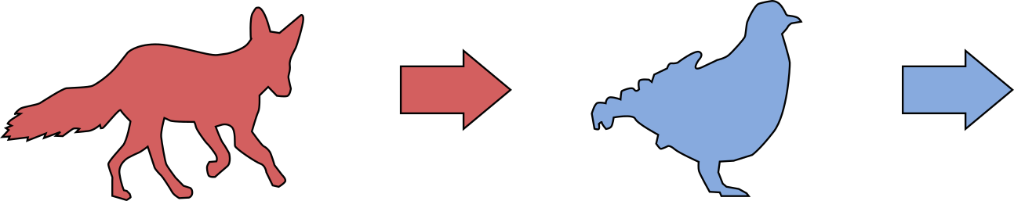
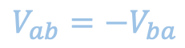
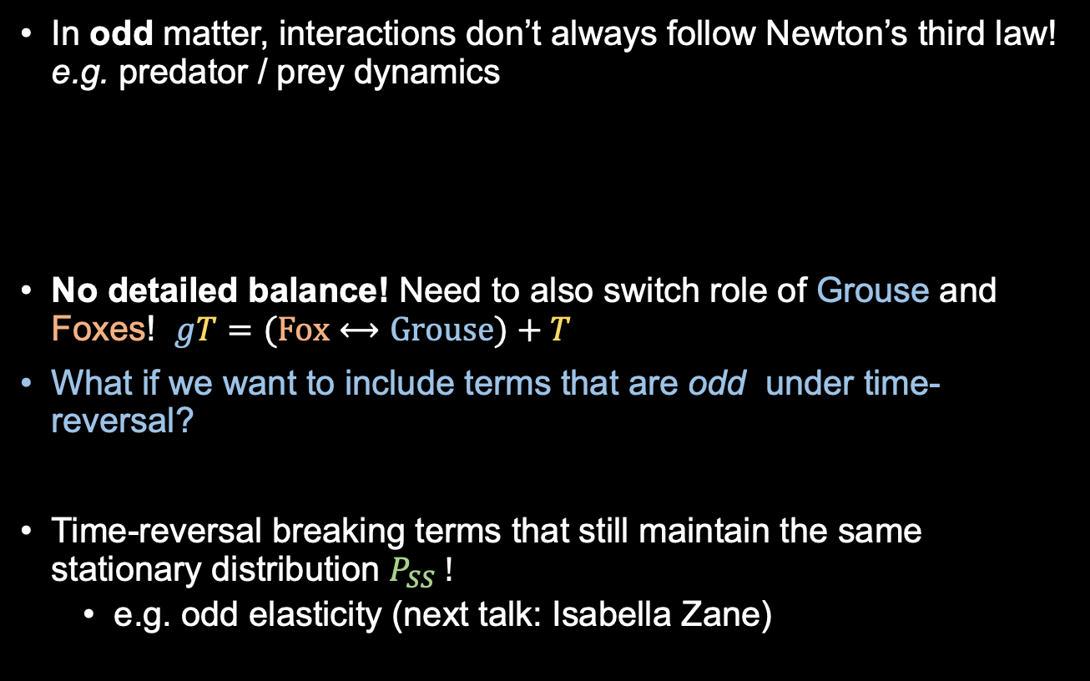

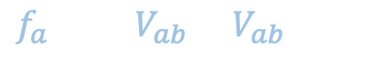

2) Breaking time-reversal: nonreciprocity!
In odd matter, interactions don’t always follow Newton’s third law! e.g. predator / prey dynamics
No detailed balance! Need to also switch role of Grouse and Foxes! $gT=(Fox⟷Grouse)+T$
What if we want to include terms that are odd under time-reversal?
Time-reversal breaking terms that still maintain the same stationary distribution $P_{SS} !$
e.g. odd elasticity (next talk: Isabella Zane)
Fox
Grouse
$$−$$
$$W=e^{−Φ}W^{T}e^{Φ}$$
$$f_{a}=∂_{b}V_{ab}−V_{ab}∂_{b}Φ$$
$$V_{ab}=−V_{ba}$$
Notes:
add

Slide 6
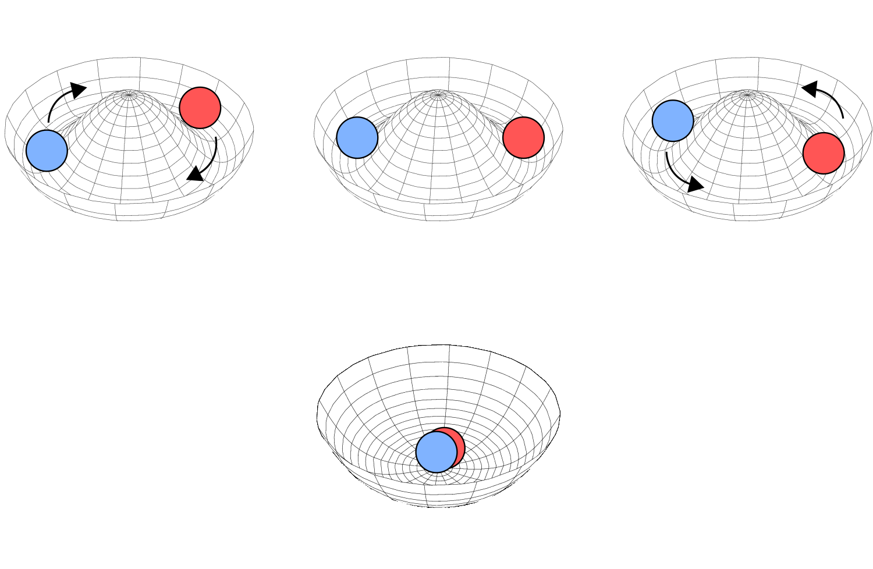
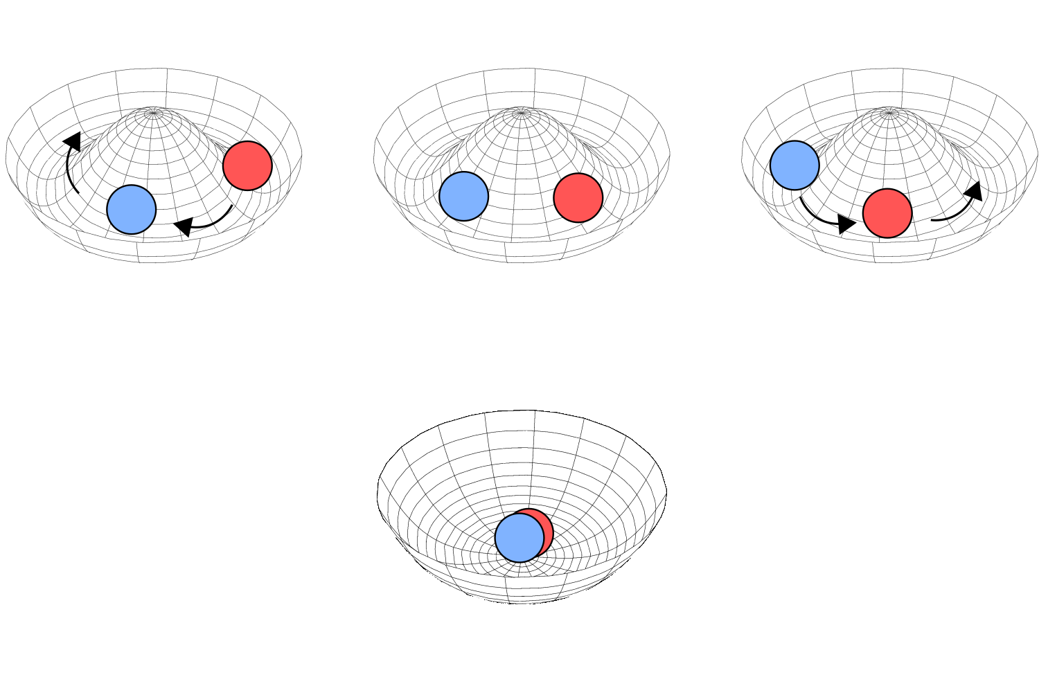

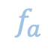
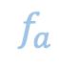
Dynamical phases
These T-odd terms are how we capture T-breaking phases such as nonreciprocal Kuramoto model
$$Φ, Q$$
$$f_{a}$$
$$f_{a}$$

Slide 7
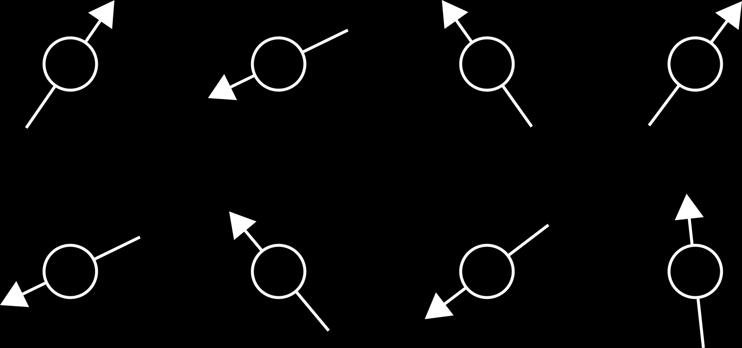
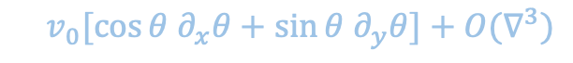
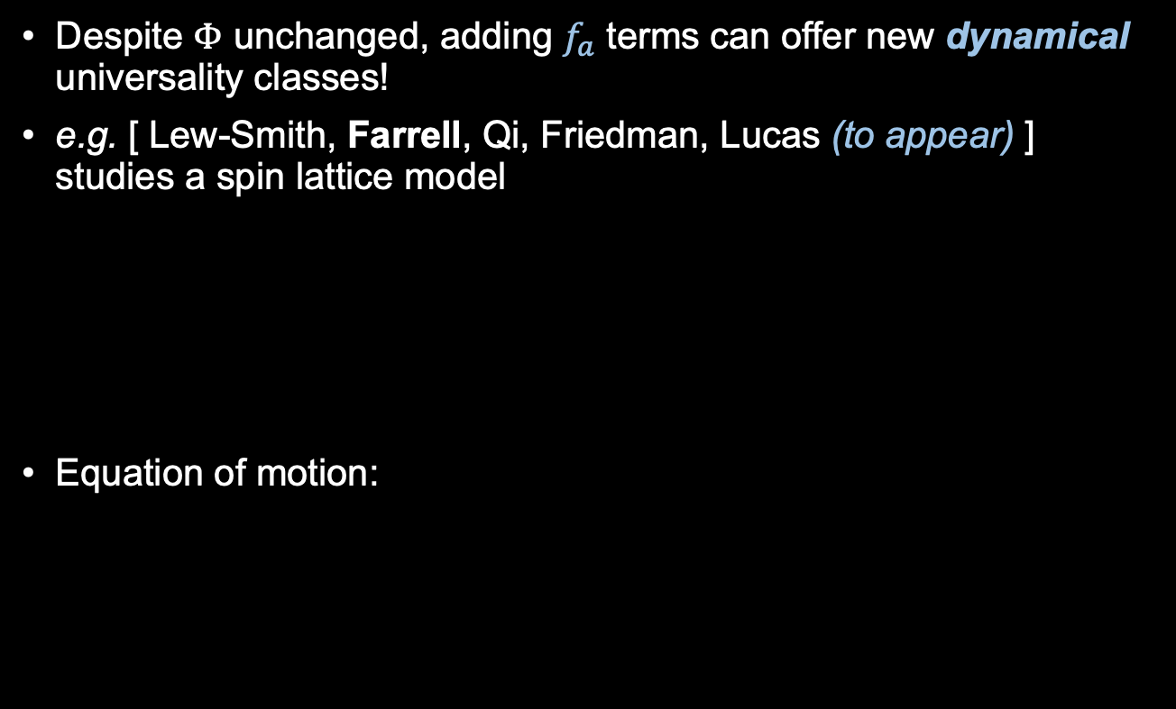
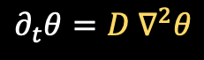
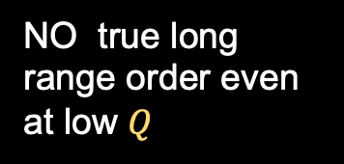
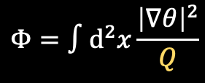
A model of “flocking” spins
Despite $Φ$ unchanged, adding $f_{a}$ terms can offer new dynamical universality classes!
e.g. [ Lew-Smith, Farrell, Qi, Friedman, Lucas (to appear) ] studies a spin lattice model
Equation of motion:
$$Φ=∫d^{2}x\frac{{\left|∇θ\right|}^{2}}{Q}$$
NO true long range order even at low $Q$
$$∂_{t}θ=D ∇^{2}θ$$
$$+ v_{0}[\cos{θ ∂_{x}θ+\sin{θ ∂_{y}θ}]}+O(∇^{3})$$
At long wavelengths, this term is identical to constant-density flocking

Slide 8
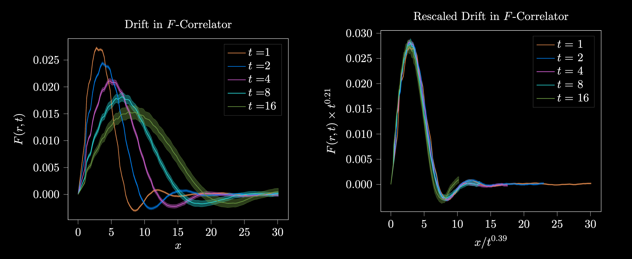
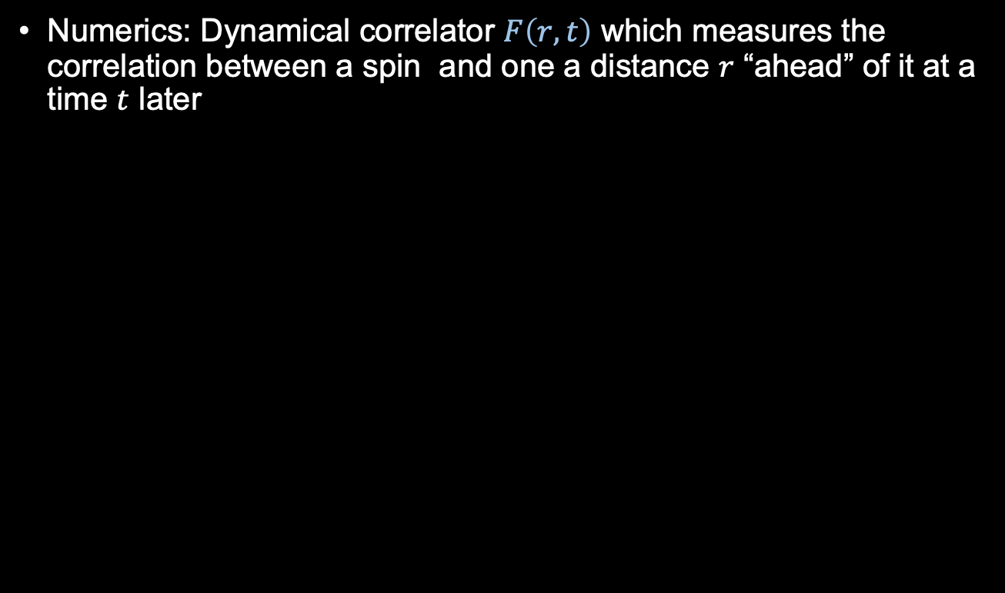
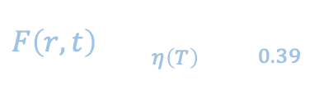
A model of “flocking” spins—numerics
Numerics: Dynamical correlator $F\left(r,t\right)$ which measures the correlation between a spin and one a distance $r$ “ahead” of it at a time $t$ later
$$F\left(r,t\right)=\frac{1}{t^{η\left(T\right)}}f\left(\frac{r}{t^{0.39}}\right)$$

Slide 9
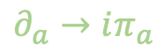



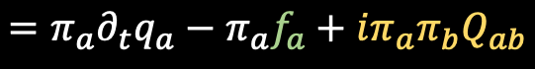

Appendix: MSR Lagrangians
For field theories, Lagrangian picture is more convenient
Start with FPE: then path integral. Integrate in a conjugate momentum $π_{a}$:
TRS symmetry easy to implement!
$$Z=\int{Dπ Dq e^{i\int{L dt}}}$$
$$L=π_{a}∂_{t}q_{a}−W(π,q)$$
$$=π_{a}∂_{t}q_{a}−π_{a}f_{a}+iπ_{a}{π_{b}Q}_{ab}$$
$$∂_{a}→iπ_{a}$$
$$π→−π_{a}+iμ_{a}$$
$$L=π_{a}∂_{t}q_{a}−π_{a}v_{a}−π_{a}Q_{ab}(iπ_{b}+μ_{b})$$

Slide 10
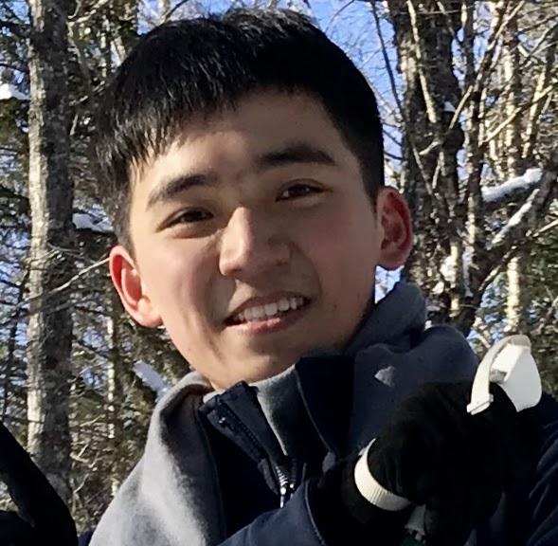

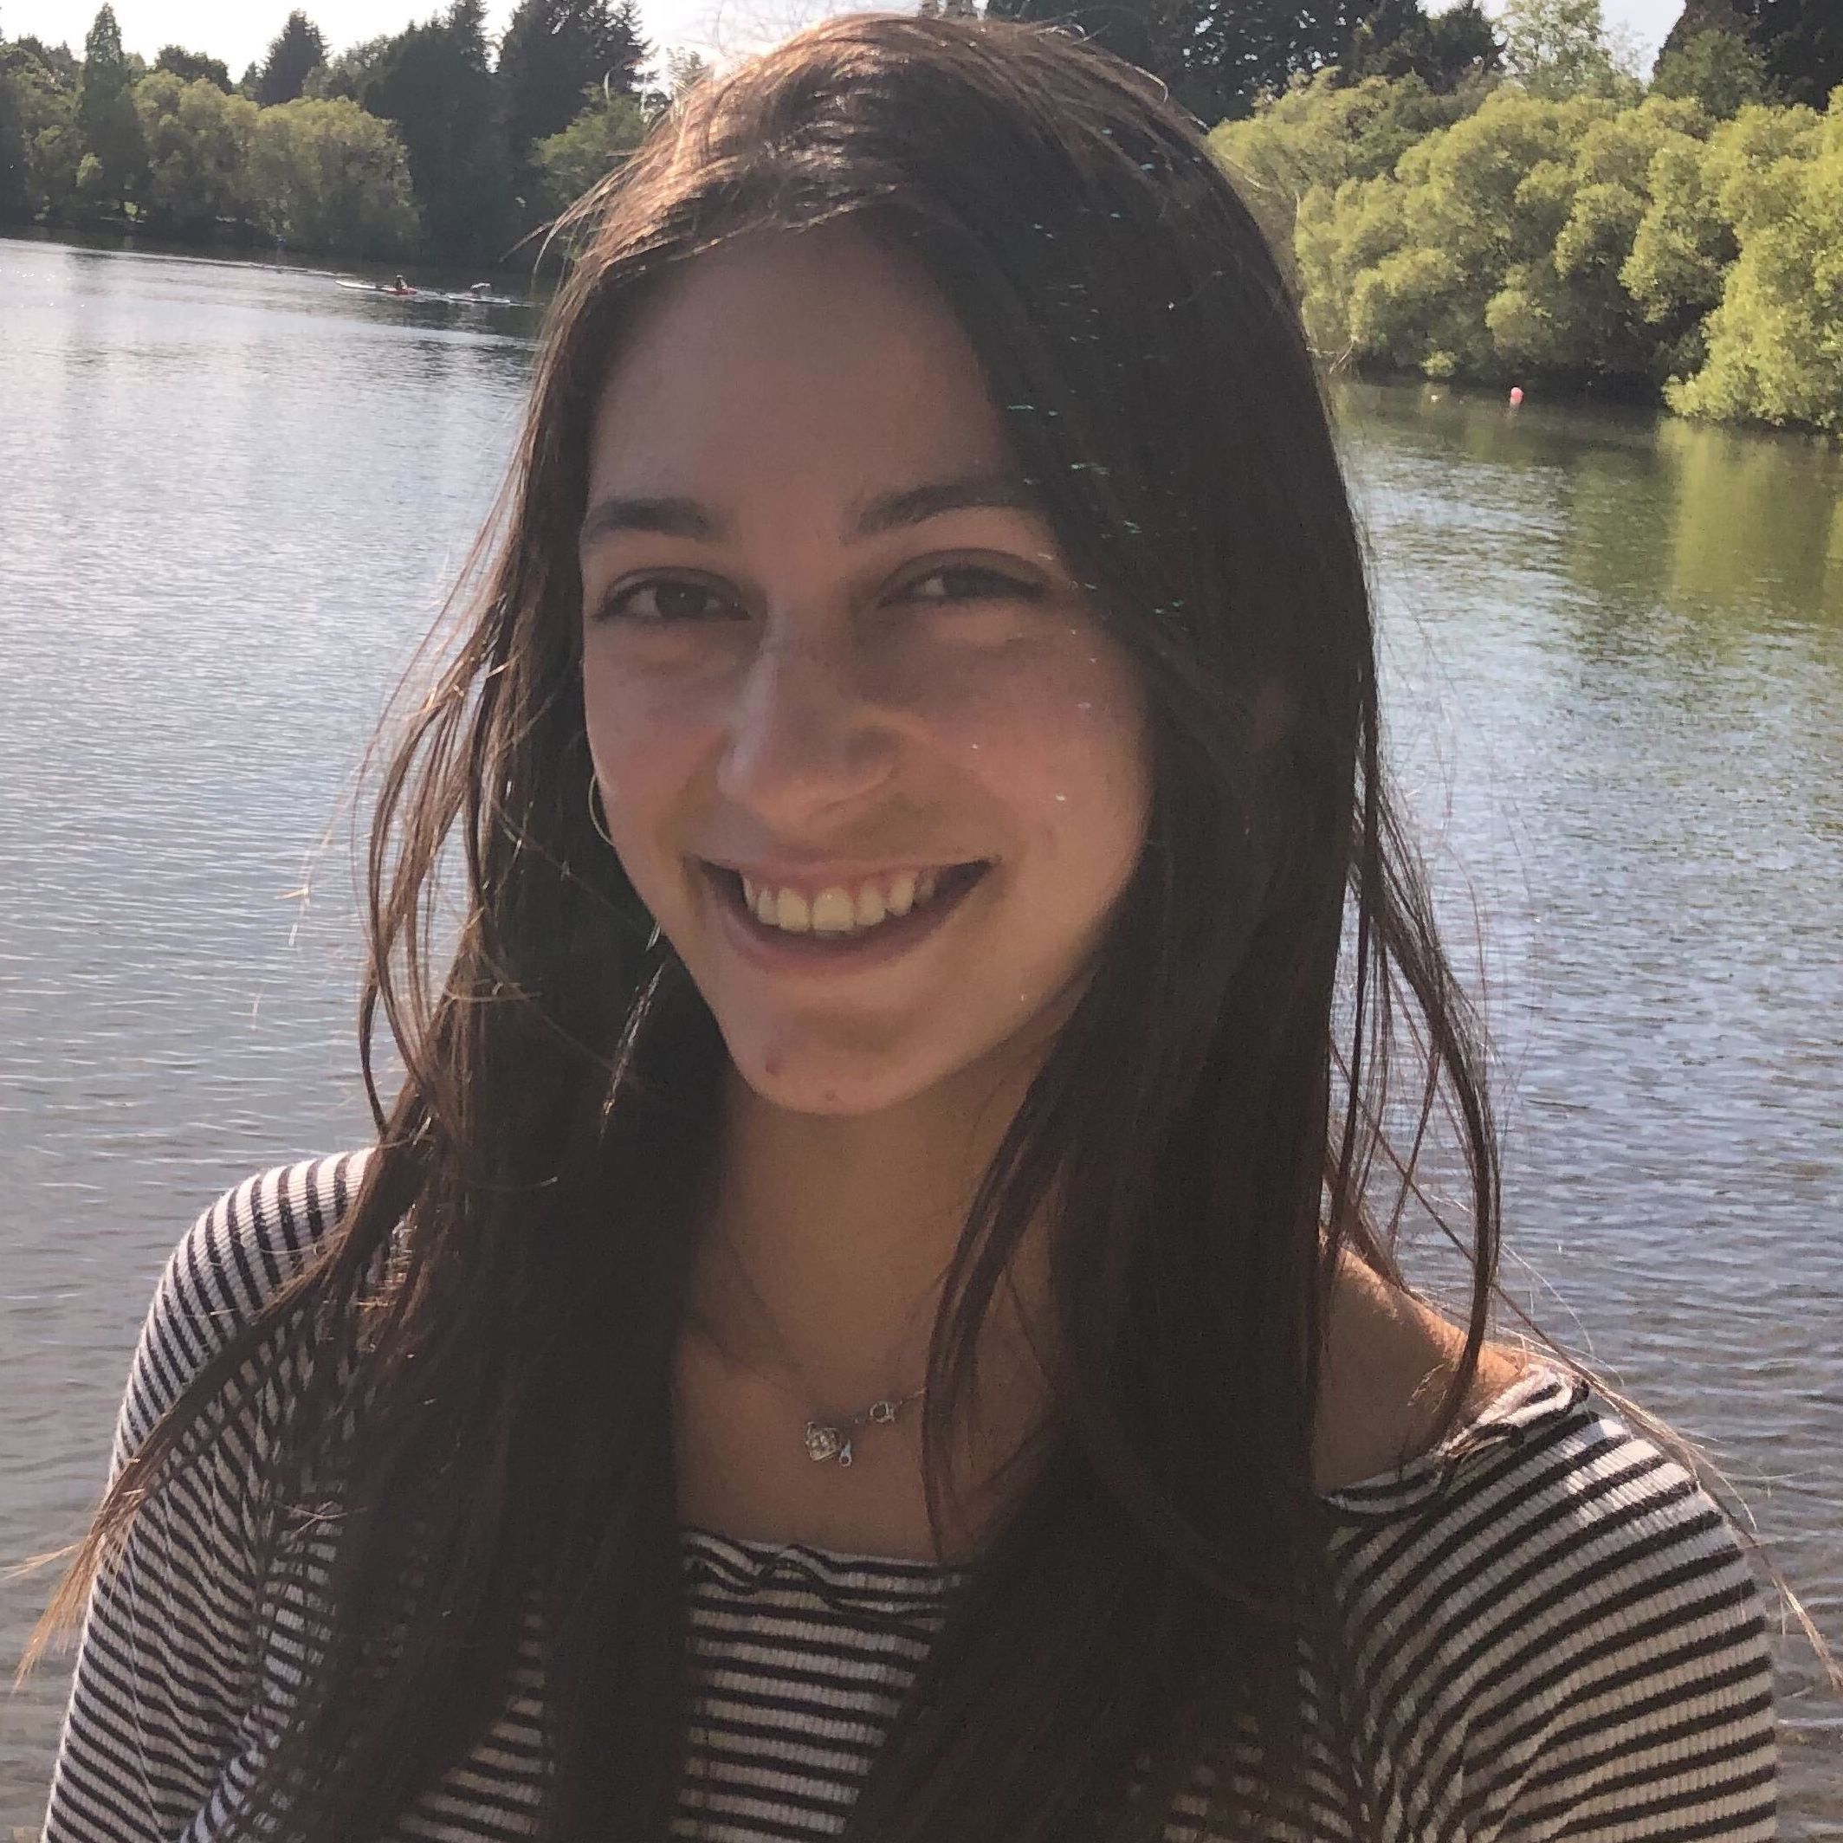
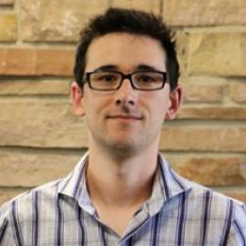
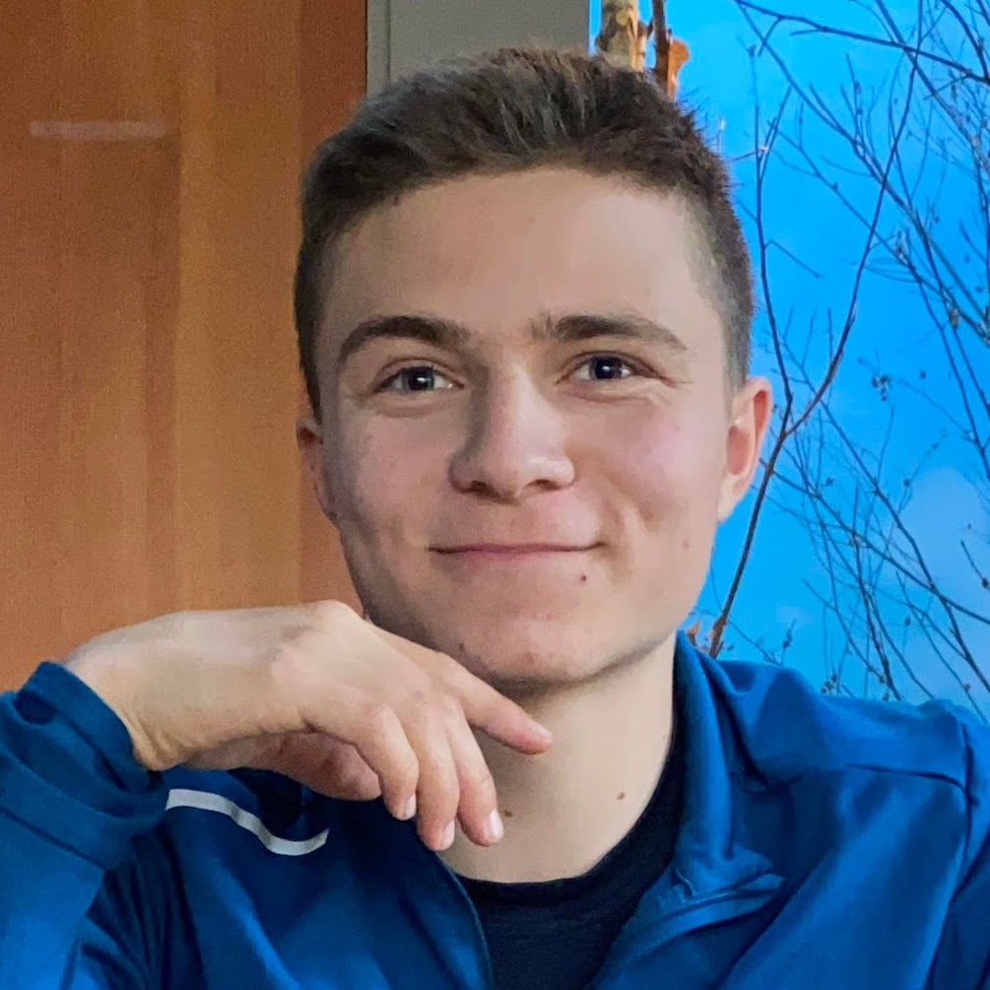
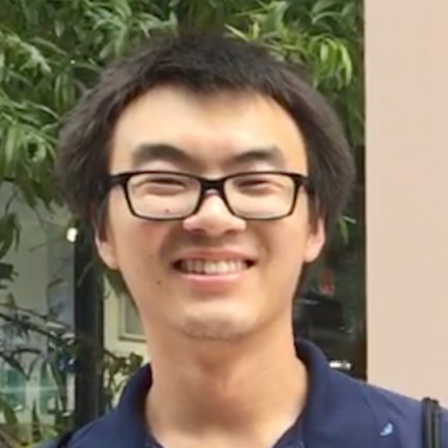
☺ Acknowledgments
Huang, Farrell, Friedman, Zane, Glorioso, Lucas, Time-reversal symmetry and effective theories for nonequilibrium matter, 2310.12233
Lew-Smith, Farrell, Qi, Friedman, Lucas (to appear)
Xiaoyang
Huang
Aaron
Friedman
Isabella
Zane
Andy
Lucas
Elijah
Lew-Smith (Brown)
Marvin
Qi

